Slide 1
DDSAnalytics Case Study
by Billy Nayden

Slide 2
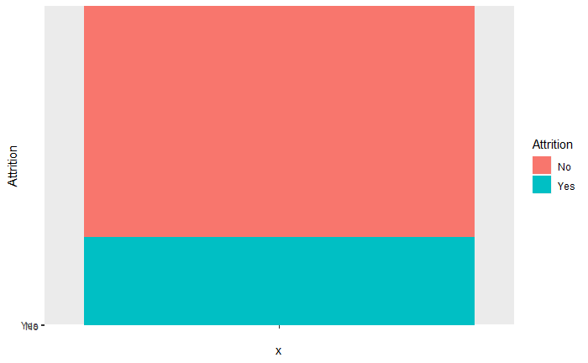
Attrition Rate
Roughly 16% of the company will leave

Slide 3
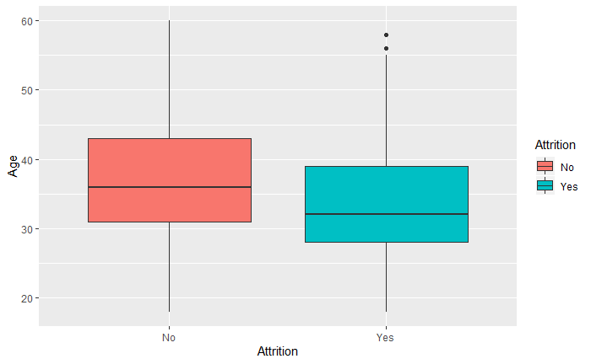
Attrition Summary
Median age for those leaving the company is lower than for those who stay

Slide 4
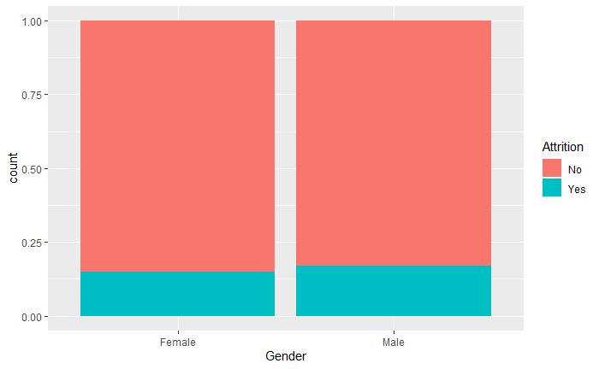
Attrition Summary
Men leave at a slighly higher rate than women

Slide 5
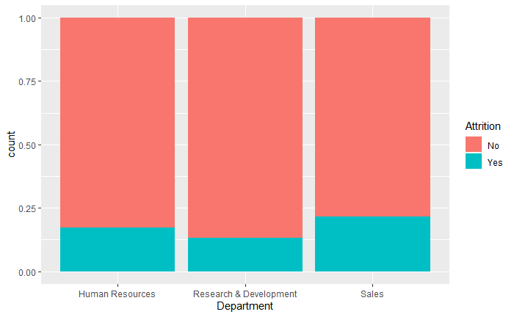
Attrition Summary
Sales has highest attrition rate of any department

Slide 6
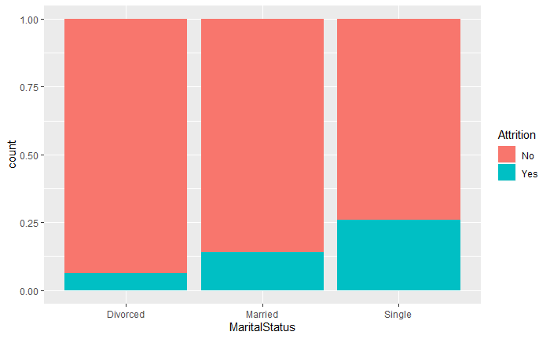
Attrition Summary
Single people are more likely to leave company

Slide 7
Our Model
31 variables to determine attrition
KNN - K- nearest neighbor
Optimal K: 21
Removed universal factors
Employee Count
Over 18
Standard Hours

Slide 8
Conclusions
Most significant factors
Overtime
Job Involvement
Marital Status
Least significant factors
Gender
Business Travel
Hourly Rate

